Slide 1

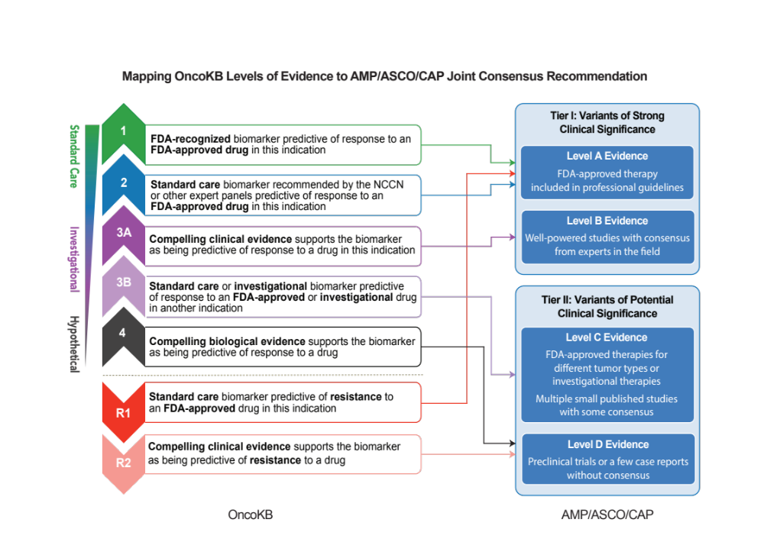

Mapping of and AMP/ASCO/CAP
Levels of Evidence
Li, MM et al., J Mol Diagn. Vol. 19 Issue 1, 2017

